Slide 1
Strictly Monotone Brouwer Trees for Well-Founded Recursion Over Multiple Arguments
Joseph Eremondi
University of Edinburgh/University of Regina
CPP 2024

Slide 2
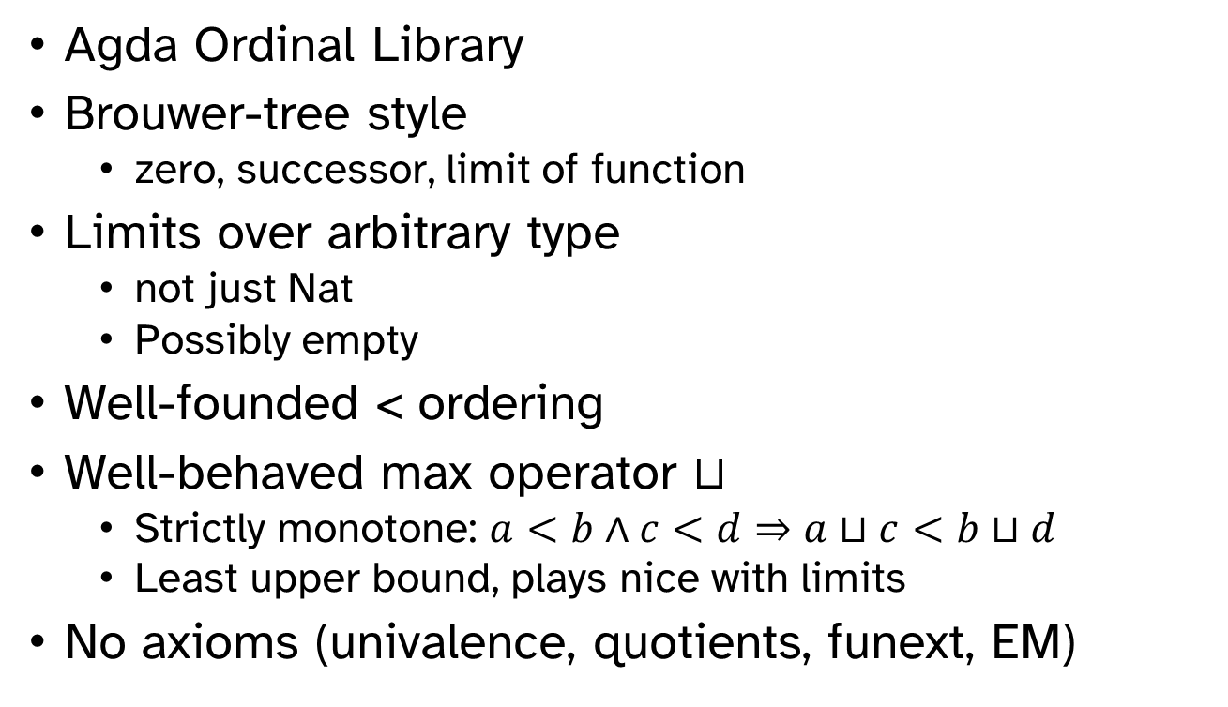
Overview: Strictly Monotone Brouwer Trees (SMB-trees)
Agda Ordinal Library
Brouwer-tree style
  zero, successor, limit of function
Limits over arbitrary type
  not just Nat
  Possibly empty
Well-founded < ordering
Well-behaved max operator $⊔$
  Strictly monotone: $a<b∧c<d⇒a⊔c<b⊔d$
  Least upper bound, plays nice with limits
No axioms (univalence, quotients, funext, EM)

Slide 3
Recursion and Dependent Types
e.g. Why we care

Slide 4
Dependent Termination
All dependently typed functions must terminate
  Consistency
    E.g. no proof of False that runs forever
  Decidable checking
    E.g. so no type comparison runs forever
      Terms inside types
Structurally Decreasing
-- Bad
m + n = S (m + (n-1))
-- Good
m + (S n) = S (m + n)

Slide 5
Limits of Structural Recursion
sort nil = nil
sort (cons h t)
= (sort
(filter (<h) t))
++ [h]
++ (sort
(filter (≥h) t))
Recur on result of filter
Shorter but not structurally smaller

Slide 6
Well-Founded Recursion
Explicitly say what’s decreasing
wfRec : WellFounded _<_
→ ((x : A)
→ ((y : A) → y < x → P y)
→ P x)
→ (x : a) → P x
Recursive fun param
sort’ self (cons h t)
= (self proof1
(filter (<h) t))
++ [h]
++ (self proof2
(filter (≥h) t))
sort = wfRec isWf sort’
Combinator computes fixed point

Slide 7
Termination for Higher Order Structures
Numbers are not enough

Slide 8
Example: Universes
Code : Type l
El : Code → Type
data Code : Type l where
Top : Code
Nat : Code
Pi : (c : Code) → (El c → Code) → Code
…
Size for Pi dom cod ?
  Bigger than max of all cod x
  Infinitely many!

Slide 9
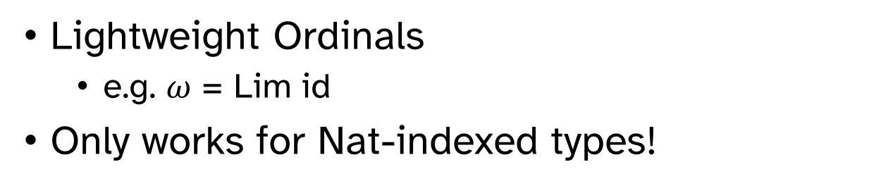
Brouwer Trees
data Tree : Type where
Z : Tree
↑ : Tree → Tree
Lim : (Nat → Tree) → Tree
Lightweight Ordinals
  e.g. $ω$ = Lim id
Only works for Nat-indexed types!

Slide 10
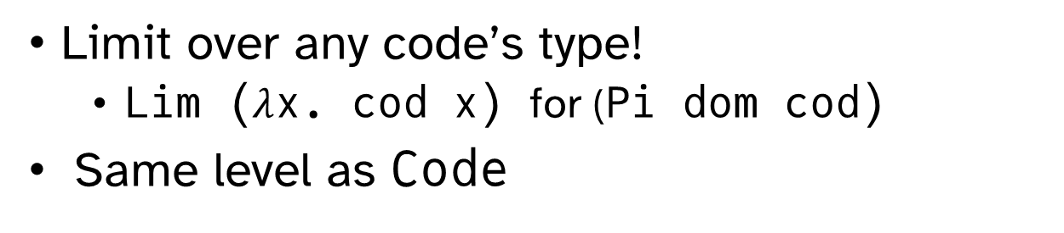
Generalizing Brouwer Trees
data Tree : Type l where
Z : Tree
↑ : Tree → Tree
Lim : {c : Code} → (El c → Tree) → Tree
Limit over any code’s type!
  Lim ($λ$x. cod x) for (Pi dom cod)
Same level as Code

Slide 11
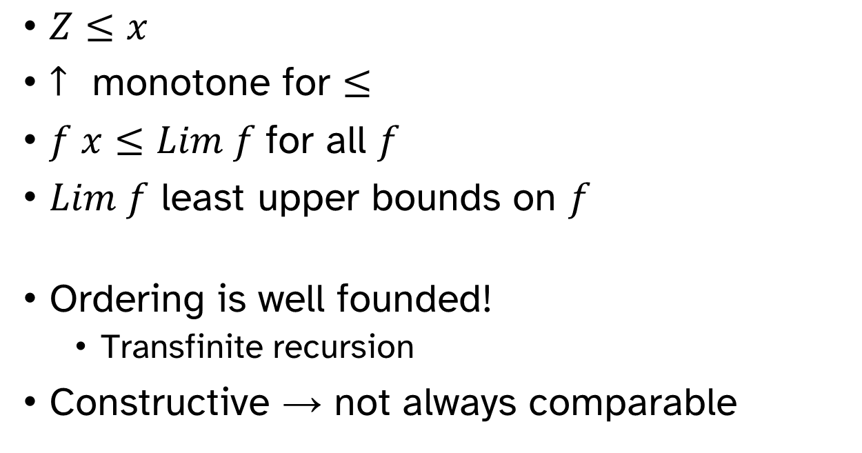
Ordering Trees
$Z≤x$
$↑$ monotone for $≤$
$f x≤Lim f$for all $f$
$Lim f$ least upper bounds on $f$
Ordering is well founded!
  Transfinite recursion
Constructive → not always comparable

Slide 12
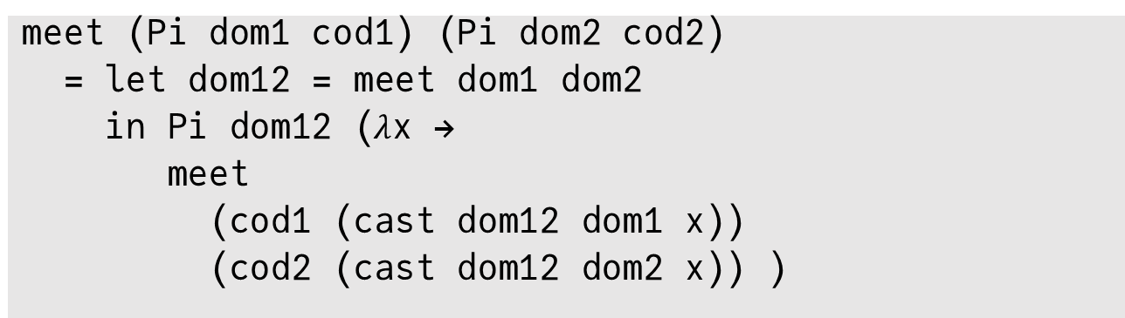
Example: Type Intersection
meet: Code → Code → Code
cast : (c d : Code) → El c → El d
  Mutually defined
  From Gradual Types
  Or e.g. coercions, subtyping, unification, etc.
meet (Pi dom1 cod1) (Pi dom2 cod2)
= let dom12 = meet dom1 dom2
in Pi dom12 ($λ$x →
meet
(cod1 (cast dom12 dom1 x))
(cod2 (cast dom12 dom2 x)) )

Slide 13
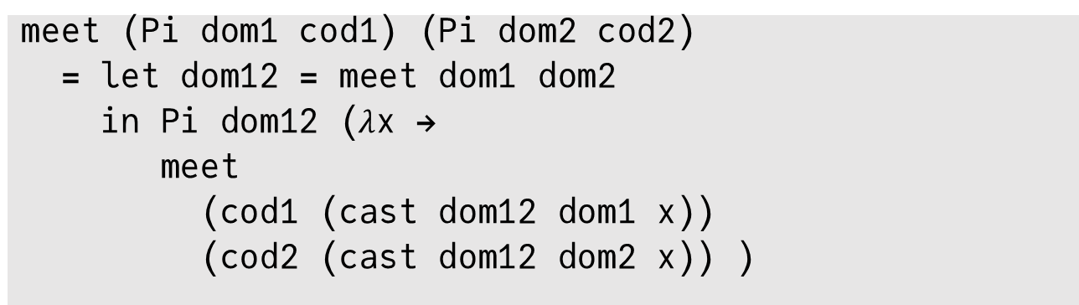
Showing Termination
Recursive cast and meet calls
  Two input codes
  Decreasing on max of codes
Need:
  Meet bounded by max (can prove)
  max (size Pi dom1 cod1) (size Pi dom2 cod2)
  > max (max dom1 dom2) dom1
Holds if max really is max!
meet (Pi dom1 cod1) (Pi dom2 cod2)
= let dom12 = meet dom1 dom2
in Pi dom12 ($λ$x →
meet
(cod1 (cast dom12 dom1 x))
(cod2 (cast dom12 dom2 x)) )

Slide 14
More Generally
Want maximum
  wfRec on multiple arguments
Should be strictly monotone
  If each argument is decreasing in size, so is their maximum
Should be well behaved
  Least upper bound
  Associative
  Commutative

Slide 15
How Not to Compute The Maximum
Two Attempts

Slide 16
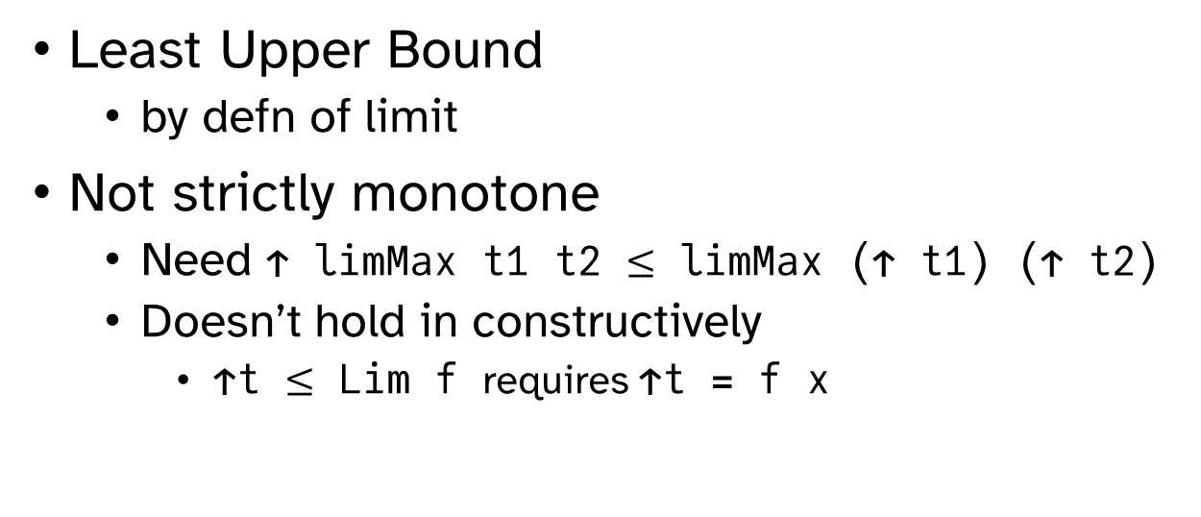
Attempt #1: Limit
limMax t1 t2 = Lim Bool ($λ$b → if b t1 t2)
Least Upper Bound
  by defn of limit
Not strictly monotone
  Need ↑ limMax t1 t2 $≤$ limMax (↑ t1) (↑ t2)
  Doesn’t hold in constructively
    ↑t $≤$ Lim f requires ↑t = f x

Slide 17
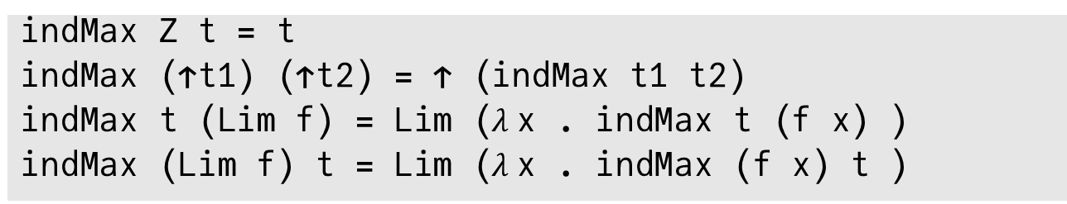
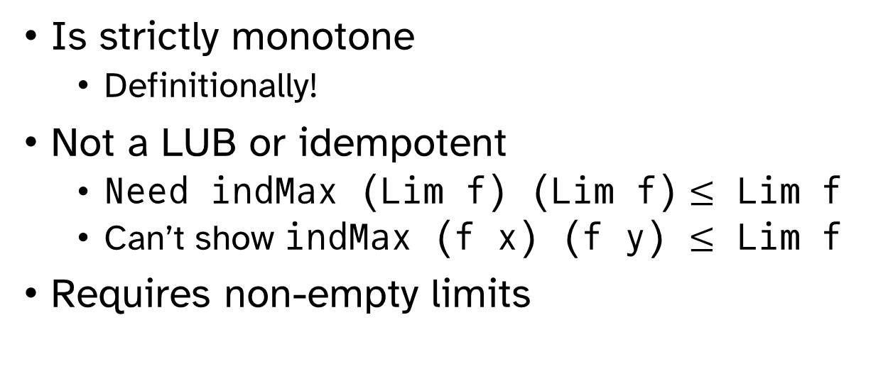
Attempt #1: Inductive
indMax Z t = t
indMax (↑t1) (↑t2) = ↑ (indMax t1 t2)
indMax t (Lim f) = Lim ($λ$x . indMax t (f x) )
indMax (Lim f) t = Lim ($λ$x . indMax (f x) t )
Is strictly monotone
  Definitionally!
Not a LUB or idempotent
  Need indMax (Lim f) (Lim f) $≤$ Lim f
  Can’t show indMax (f x) (f y) $≤$ Lim f
Requires non-empty limits

Slide 18
Our Contribution: Restricting to Well Behaved Trees

Slide 19
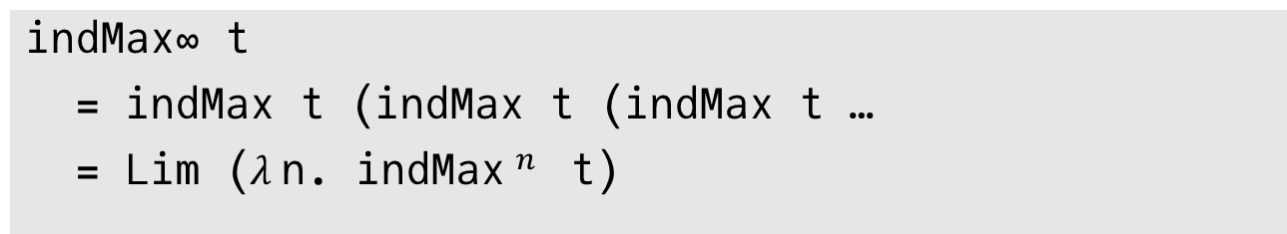
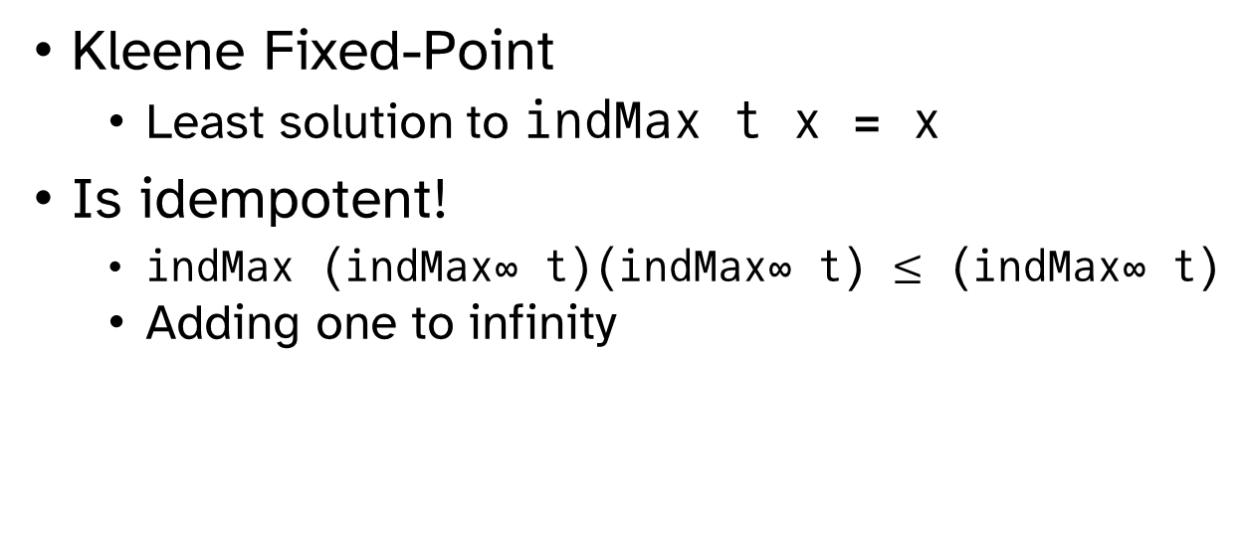
Idempotent Fixed Points
indMax∞ t
= indMax t (indMax t (indMax t …
= Lim ($λ$n. indMax$^{n}$ t)
Kleene Fixed-Point
  Least solution to indMax t x = x
Is idempotent!
  indMax (indMax∞ t)(indMax∞ t) $≤$ (indMax∞ t)
  Adding one to infinity

Slide 20
Non-Empty Limits
Lim’ : {c : Code} → (Maybe (El c) → Tree) → Tree
Add 0 to each limit sequence
Ensures non-empty
Gives “default” value
  Never need to decide if code inhabited

Slide 21
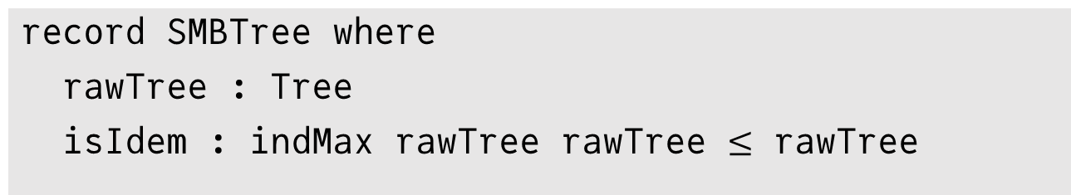
The Well Behaved Subset
record SMBTree where
rawTree : Tree
isIdem : indMax rawTree rawTree $≤$ rawTree
Subset of trees that are idempotent
SMBLim : {c : Code} → (El c → SMBTree) → SMBTree
SMBLim f = {rawTree =
indMax∞ (Lim’ (maybe’ (rawTree . f) Z)
, isIdem = … }
Take indMax∞ of all limits
Add 0 to all limits

Slide 22
Abstracting Away
Opaque Interface
Smart constructors
  Z, ↑, and Lim
  Convert any Tree to SMBTree
Ordering
  Same constructors as for Brouwer trees
  Preserved by conversion
indMax is now a strictly monotone LUB
  Got rid of all the bad trees

Slide 23
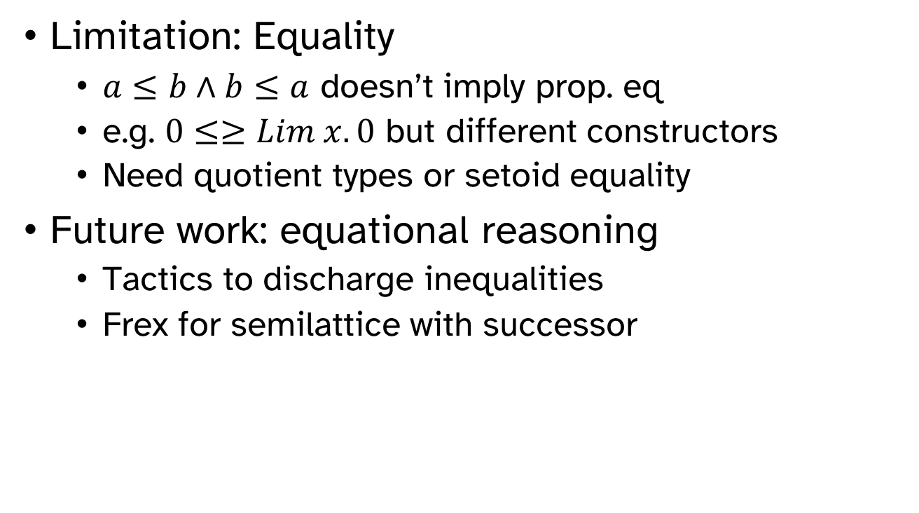
Discussion
Limitation: Equality
  $a≤b∧b≤a$ doesn’t imply prop. eq
  e.g. $0≤≥Lim x. 0$ but different constructors
  Need quotient types or setoid equality
Future work: equational reasoning
  Tactics to discharge inequalities
  Frex for semilattice with successor

Slide 24
Thank You!
Also, I’m currently recruiting new MSc or PhD students. Email jeremondi@uregina.ca for more info!

